Slide 1



AIR AWARE
Smart Air Quality Prediction System
s.sneha
Group 2

Slide 2

PROJECT OVERVIEW
AirAware is a smart system that predicts Air Quality Index (AQI) using a trained machine learning model.
The project includes an interactive dashboard, pollutant analysis, and downloadable reports.
Now upgraded with ML backend integration and dark mode UI.
01

Slide 3
PROBLEM STATEMENT
Air pollution is increasing across major cities, affecting health and daily decisions.
People lack simple tools to check potential air quality.
1.
2.
AirAware solves this by predicting AQI using ML and providing clear visual insights.
02

Slide 4
FEATURES
  Full responsive UI: Home, Dashboard, About, Contact
  Line charts & bar charts with Chart.js
  ML prediction
  Downloadable PDF AQI report
  Smooth navigation and clean UI design
  Dark mode support
03

Slide 5
FRONTEND OVERVIEW
  Built using HTML, CSS, and JavaScript with clean reusable components.
  Dashboard shows PM2.5, CO, NO₂, and AQI in card format.
  Chart.js used for visualizing pollutant trends and AQI comparison.
04

Slide 6


MILESTONE-2 BACKEND WORK
✔ Connected dashboard UI to Flask backend
✔ Implemented /predict API using ML model
✔ Integrated ML model (Linear Regression model trained using Delhi dataset)
✔ Created /download_report route for PDF generation
✔ Ensured backend sends structured JSON for charts & AQI cards
05

Slide 7
TECH STACK
Frontend: HTML, CSS, JavaScript, Chart.js
Backend: Python Flask
Machine Learning: sklearn, pandas, numpy
Dataset: City-Day dataset (PM2.5, CO, NO₂, AQI)
PDF Generation: FPDF
Version Control: GitHub
06

Slide 8
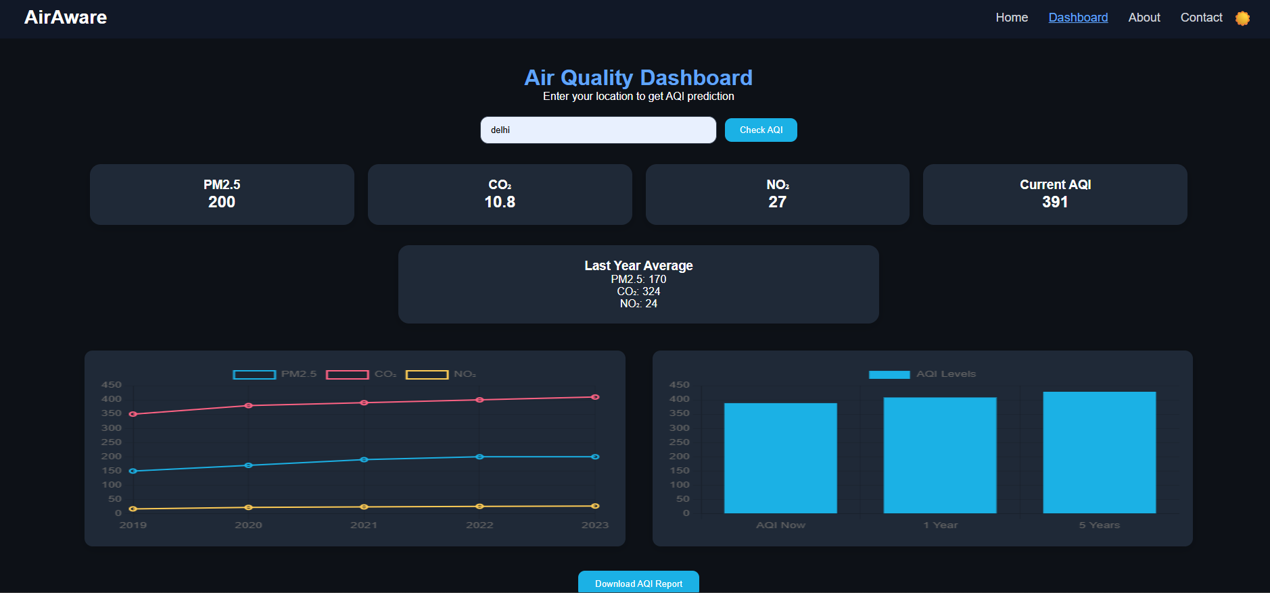
07

Slide 9
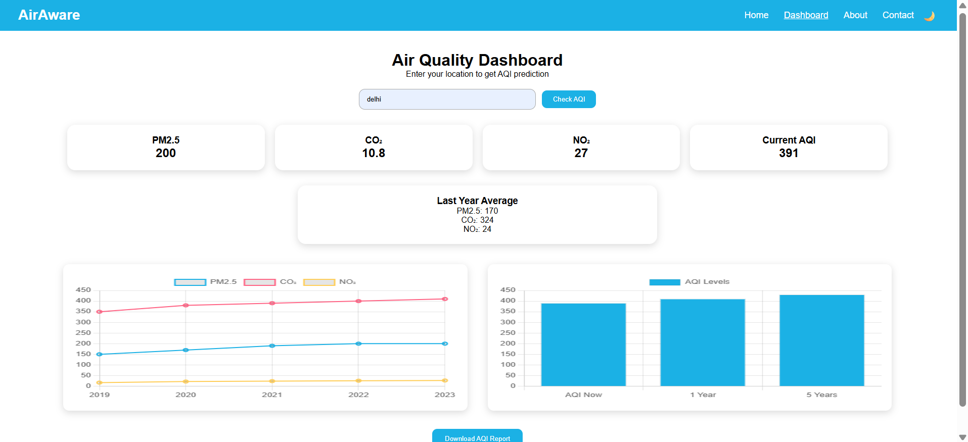
08

Slide 10
CONCLUSION
Milestone-2 successfully completes the full functionality of the AirAware prediction dashboard with ML integration and improved UI.
The project is ready for final polishing and backend enhancements in Milestone-3.
09

Slide 11
THANK YOU
10

